Slide 1

Introduction to
Support Vector Machines

Slide 2
Reading Assignment
Chapter 9 of
Introduction to Statistical Learning
By Gareth James, et al.

Slide 3
Support Vector Machines
Support vector machines (SVMs) are supervised learning models with associated learning algorithms that analyze data and recognize patterns, used for classification and regression analysis.

Slide 4
Support Vector Machines
Given a set of training examples, each marked for belonging to one of two categories, an SVM training algorithm builds a model that assigns new examples into one category or the other, making it a non-probabilistic binary linear classifier.

Slide 5
Support Vector Machines
An SVM model is a representation of the examples as points in space, mapped so that the examples of the separate categories are divided by a clear gap that is as wide as possible.

Slide 6
Support Vector Machines
New examples are then mapped into that same space and predicted to belong to a category based on which side of the gap they fall on.

Slide 7
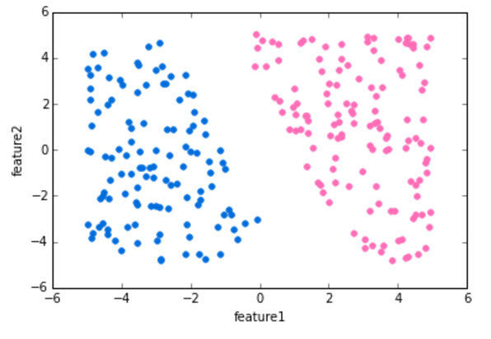
Support Vector Machines
Let’s show the basic intuition behind SVMs. Imagine the labeled training data below:

Slide 8
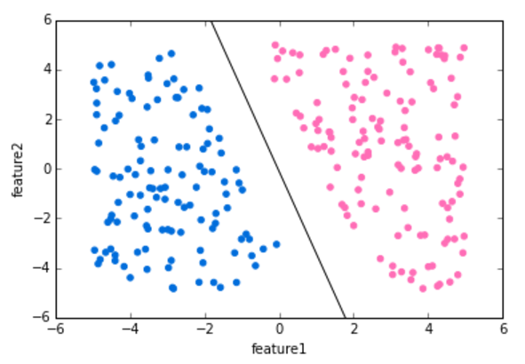
Support Vector Machines
We can draw a separating “hyperplane” between the classes.

Slide 9
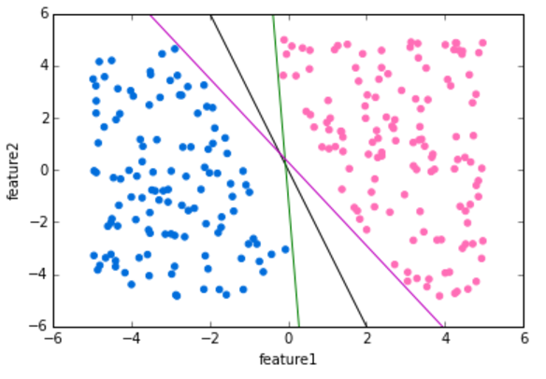
Support Vector Machines
But we have many options of hyperplanes that separate perfectly...

Slide 10
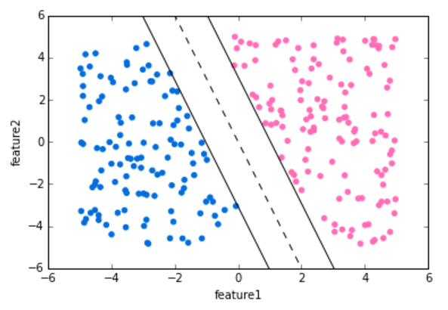
Support Vector Machines
We would like to choose a hyperplane that maximizes the margin between classes

Slide 11
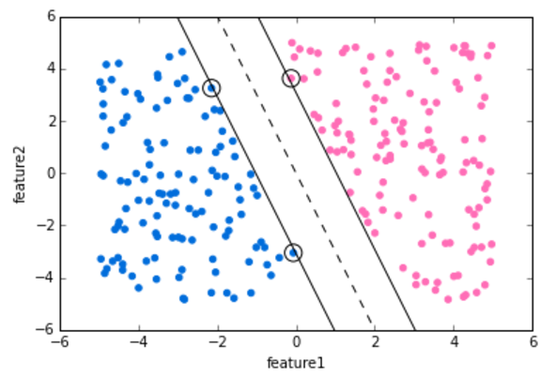
Support Vector Machines
The vector points that the margin lines touch are known as Support Vectors.

Slide 12
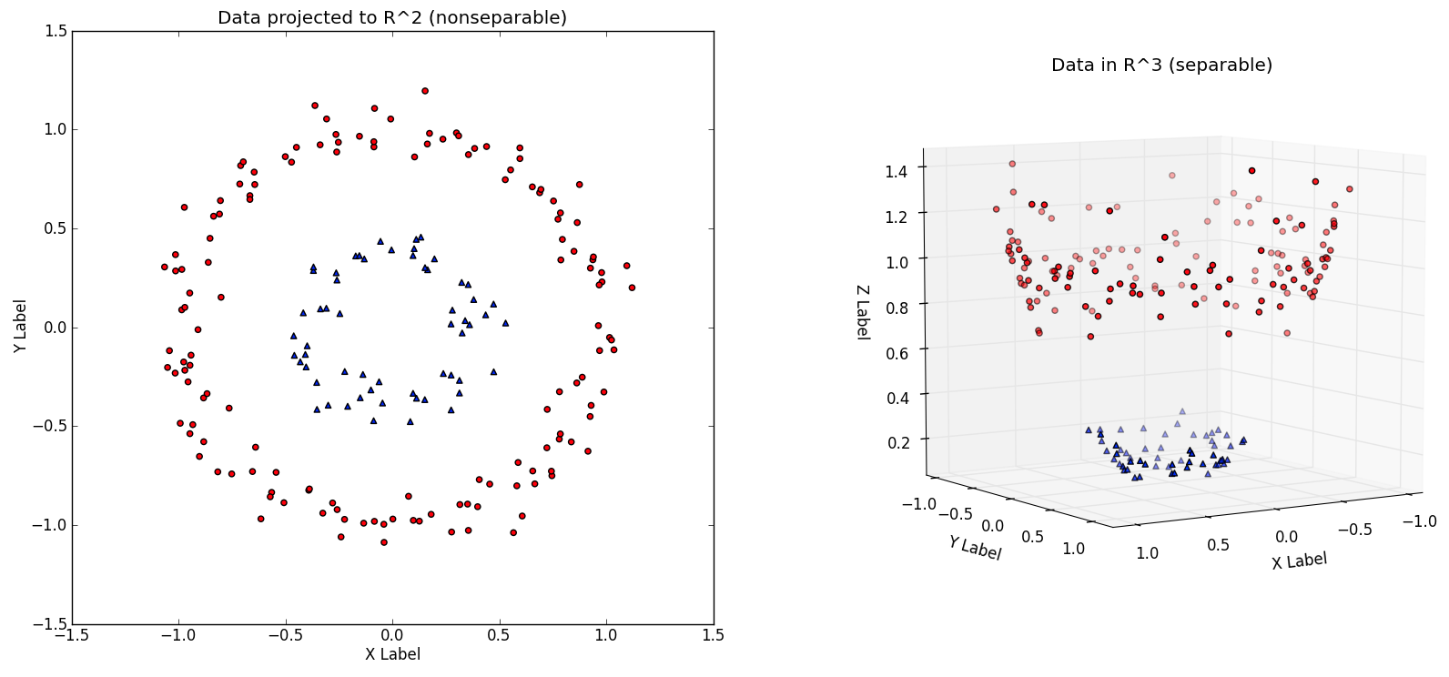
Support Vector Machines
We can expand this idea to non-linearly separable data through the “kernel trick”.

Slide 13
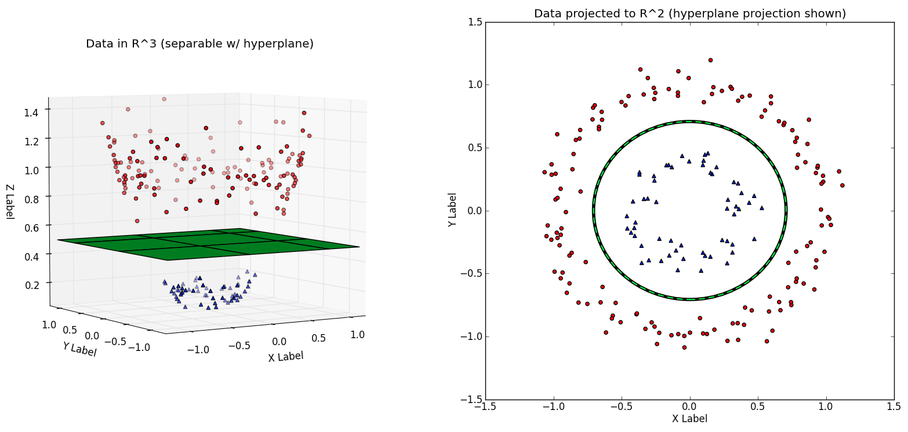
Support Vector Machines
Check out YouTube for nice 3D Visualization videos explaining this idea. Refer to reading for math behind this.

Slide 14
Example with R
Let's go to RStudio and begin to explore an example, then you’ll have a project to test your understanding!

